Slide 1
2.2 Files and Input/Output

Slide 2
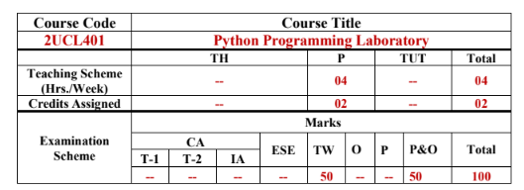

Slide 3
Python Object
In Python, a physical file must be mapped to a built-in file object with the help of built-in function open().
Open():function returns a file object, also called a handle, as it is used to read or modify the file accordingly.
>>> f = open("test.txt") # open file in current directory
>>> f = open("C:/Python33/README.txt") # specifying full path
>>> f = open("test.txt",'w') # write in text mode

Slide 4
Eg-
To open a file for reading it is enough to specify the name of the file:
f = open("demofile.txt")
The code above is the same as:
f = open("demofile.txt", "rt")
Because "r" for read, and "t" for text are the default values, you do not need to specify them.
Note: Make sure the file exists, or else you will get an error.

Slide 5
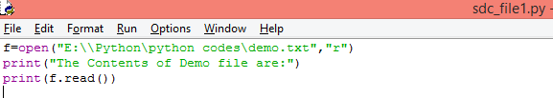


Opening a demo file with Path
With t or text mode
Output is same in both cases-

Slide 6
open()
Syntax: file object = open(file name[, access mode][, buffersize])
The access mode parameter is an optional parameter which decides the purpose of opening a file, e.g. read, write, append, etc. Use access mode 'w' to write data in a file ,'r' to read data and 'a' to append.
The optional buffersize argument specifies the file's desired buffer size:
0 means unbuffered,
1 means line buffered and
other positive values indicate the buffer size.
A negative buffersize uses the default value.

Slide 7
open()
The default is reading in text mode. In this mode, we get strings when reading from the file.
On the other hand, binary mode returns bytes and this is the mode to be used when dealing with non-text files like image or exe files.

Slide 8
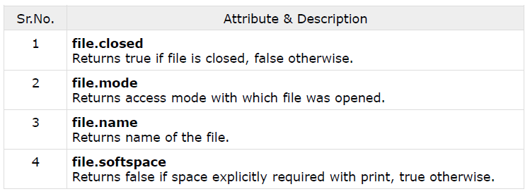
File Object Attributes
A file object has many attributes associated with it.
There are three different categories of file objects:
Text files
Buffered binary files
Raw binary files
Each of these file types are defined in the io module

Slide 9
Python File Access Modes
There are four different methods (modes) for opening a file:
"r" - Read - Default value. Opens a file for reading, error if the file does not exist
"w" - Write - Opens a file for writing, creates the file if it does not exist
"x" - Create - Creates the specified file, returns an error if the file exists
"a" - Append - Opens a file for appending, creates the file if it does not exist
In addition you can specify if the file should be handled as binary or text mode
"t" - Text - Default value. Text mode
"b" - Binary - Binary mode (e.g. images)

Slide 10
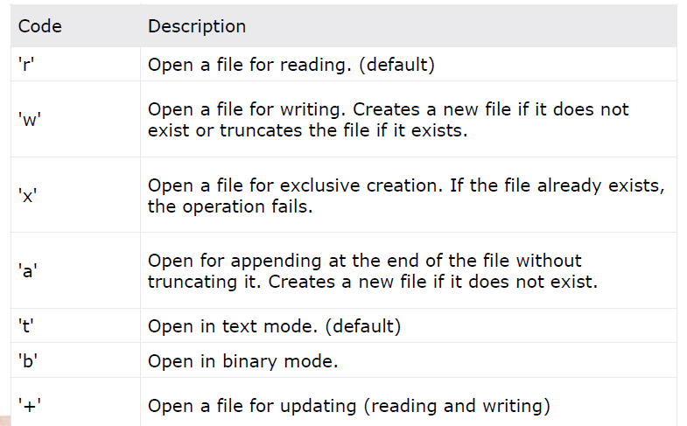
Python File Access Modes

Slide 11
Reading File
Reading afile
fileObject.read([count])
The read() method reads the specified count of characters at once.
The readline() method reads one line each time from the file.
The readlines() method reads all lines from the file in a list.
Writing in afile
fileObject.write(string)
The write() method writes any string to an open file.

Slide 12
Reading File
To read a file in Python, open the file in reading mode.
Three different methods are provided to read data from file.
1.read(size):
reads the specified size of characters starting from the current position.
If size parameter is not specified, it reads and returns up to the end of the file.
>>> f = open("test.txt",'r')
>>> f.read(4) # read the first 4 data
>>> f.read() # read in the rest till end of file

Slide 13
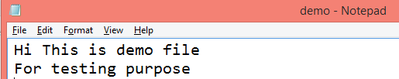
Demo File
demo.txt

Slide 14


Read Only Parts of the File
By default the read() method returns the whole text, but you can also specify how many characters you want to return:
Example
Return the 7 first characters of the file:
Output-

Slide 15
2.readline():
reads the characters starting from the current reading position up to a newline character.
readline() method will return a first line, and then will point to the second line in the file.
f=open("myfile.txt","r")
line=f.readline()
print(line)
f.close()
3.readlines(): reads all lines until the end of file
>>> f.readlines()

Slide 16


readline()
You can return one line by using the readline() method:
Example
Read one line of the file:
Output-

Slide 17
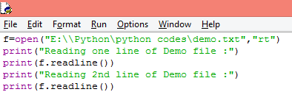
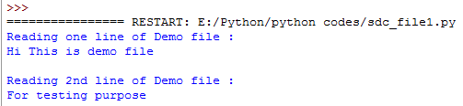
readline()
By calling readline() two times, you can read the two first lines:
Example
Read two lines of the file:
Output-

Slide 18
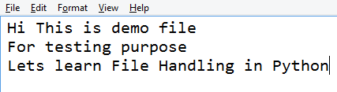
Demo File
demo.txt

Slide 19
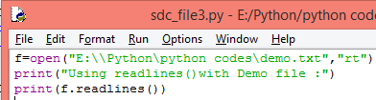
readlines()
Using readlines() method
Returns List of Lines from the File
Example
Output-

Slide 20
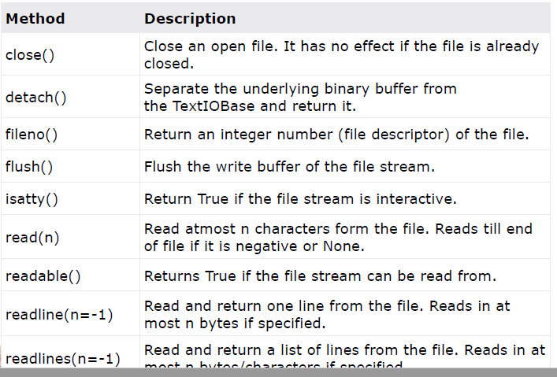
Python File Methods

Slide 21
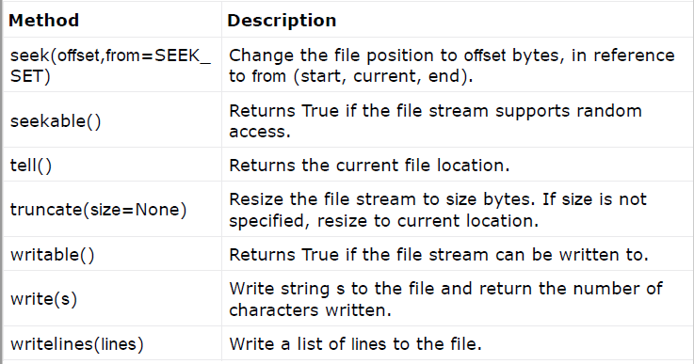
Python File Methods

Slide 22
How to close a file Using Python?
Opening files create a stream of the data buffer.
Closing a file will free up the resources that were tied with the file i.e. close this stream and is done using Python close() method.
Python has a garbage collector to clean up unreferenced objects but, we must not rely on it to close the file.

Slide 23
How to close a file Using Python?
f = open("test.txt",encoding = 'utf-8')
# perform file operations
f.close()
This method is not safe
If an exception occurs while performing some operation with the file, the code exits without closing the file.

Slide 24
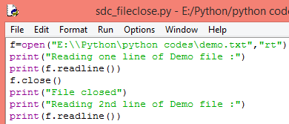
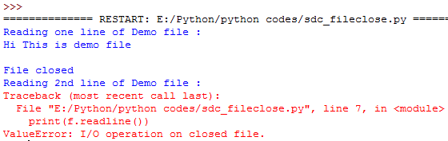
How to close a file Using Python?
It is a good practice to always close the file when you are done with it.
You should always close your files, in some cases, due to buffering, changes made to a file may not show until you close the file.

Slide 25
How to close a file Using Python?
A safer way is to use a try...finally block.
try:
f = open("test.txt",encoding = 'utf-8')
# perform file operations
finally:
f.close()
This way, we are guaranteed that the file is properly closed even if an exception is raised, causing program flow to stop.

Slide 26
The with Statement
The best way to close the file is using the with statement.
This ensures that the file is closed when the “block inside with” is exited.
The with statement allows us to automatically close the file once we are done working with it.

Slide 27
The with Statement
We don't need to explicitly call the close() method. It is done internally
with open("test.txt",encoding = 'utf-8') as f:
# perform file operations
With() can be used to use write function along
with open("file.txt", "w") as f:
f.write("Hello World!!!")
with open("file1.txt", "r") as file:

Slide 28
read a file line-by-line using a loop
This is both efficient and fast.
>>> for line in f:
print(line)
Eg-
f=open("E:\\Python\python codes\demo.txt","rt")
print("Using for loop to read file contents :")
print("Loop through the file line by line")
for x in f:
print(x)

Slide 29
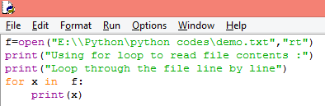
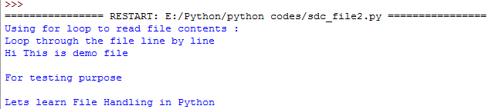
Read File using for loops
By looping through the lines of the file, you can read the whole file, line by line:
Example
Loop through the file line by line:
Output-

Slide 30
Read File using for loops
Question: Why is the output from the for loop double-spaced?
Answer: print gives you a \n and there was one on the end of each line.
Question: How can you single space the output?
Strip the newline character from the end of each line before you print.
Output-

Slide 31
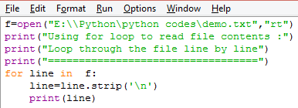
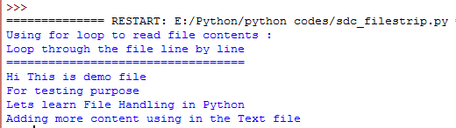
Read File using for loops
Using strip
Example
Output-

Slide 32
Knowing Whether a File Exists or Not
To delete a file, you must import the OS module, and run its os.remove() function:
import os
os.remove("demofile.txt")
To avoid getting an error, you might want to check if the file exists before you try to delete it:
import os
if os.path.exists("demofile.txt"):
os.remove("demofile.txt")
else:
print("The file does not exist")

Slide 33
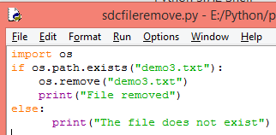

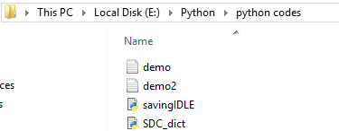
Knowing Whether a File Exists or Not
To avoid getting an error, you might want to check if the file exists before you try to delete it:
Output-
No demo3 file

Slide 34
Appending Text to a File
The "w" mode will always treat the file as a new file. In other words, an existing file opened with "w" mode will lose its earlier contents.
In order to add more data to existing file, use the "a" or "a+" mode.
f=open("D:\myfile.txt","a+")
f.write("Hello! Learning to append.")
line=f.readline()
f.close()

Slide 35
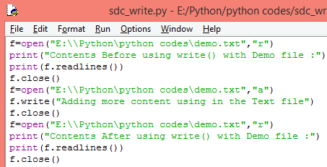
Appending Text to a File
To write to an existing file, you must add a parameter to the open() function:
"a" - Append - will append to the end of the file
"w" - Write - will overwrite any existing content
Output

Slide 36
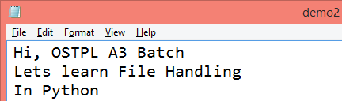
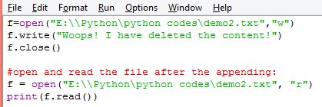

Writing to a File
The "w" method will overwrite the entire file.
Initial text file-demo2.txt
Code-
Output-
Demo2.txt

Slide 37
Seek() & tell()
seek(): function is used to set the current read/write at a specific position.
Syntax: f.seek(offset, from)
Here, the from parameter takes the following values:
0 : offset calculated from the beginning
1 : offset calculated from the current position
2 : offset calculated from the end

Slide 38
Seek() & tell()
Eg of seek():
f=open("D:\myfile.txt","r+")
f.seek(6,0)
lines=f.readlines()
for line in lines:
print(line)
f.close()
Output-
World
Explanation-
myfile.txt contains "Hello World" text
H | e | l | l | o |  | W | o | r | l | d
0 | 1 | 2 | 3 | 4 | 5 | 6 | 7 | 8 | 9 | 10

Slide 39
Seek() & tell()
tell(): returns our current position (in number of bytes).
>>> f.tell() # get the current file position

Slide 40
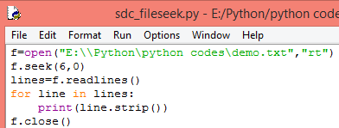
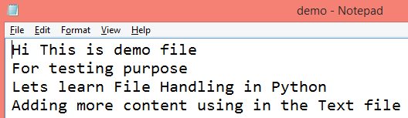

Seek() & tell()
Eg-Using Seek from Beginning
Text file-
Output-

Slide 41
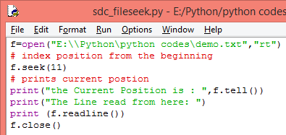
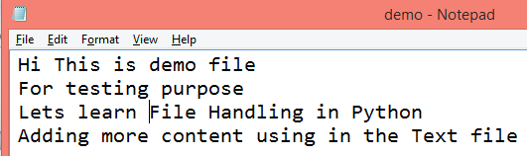

Seek() & tell()
Eg-Using seek with current position
Text file-Current position 11
Output-

Slide 42
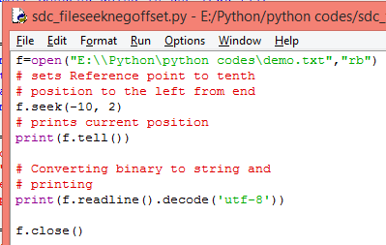
Seek() & tell()
Seek() function with negative offset only works when file is opened in binary mode.

Slide 43
decode()
Description
Python string method decode() decodes the string using the codec registered for encoding. It defaults to the default string encoding.
Syntax
Str.decode(encoding='UTF-8',errors='strict')
Return Value
Decoded string.
errors −
This may be given to set a different error handling scheme. The default for errors is 'strict', meaning that encoding errors raise a UnicodeError.
Other possible values are 'ignore', 'replace', 'xmlcharrefreplace', 'backslashreplace' etc

Slide 44
decode()
Example
#!/usr/bin/python
Str = "this is string example....wow!!!";
Str = Str.encode('base64','strict');
print "Encoded String: " + Str
print "Decoded String: " + Str.decode('base64','strict')
Result
Encoded String: dGhpcyBpcyBzdHJpbmcgZXhhbXBsZS4uLi53b3chISE=
Decoded String: this is string example....wow!!!

Slide 45

Seek() & tell()
Seek() function with negative offset only works when file is opened in binary mode.
Text file-
f.seek(-10,2)=-10 steps from end of the file i.e. at space before “ Text…..”
Output-

Slide 46
Binary files
The open() function opens a file in text format by default.
Binary files can range from image files like JPEGs or GIFs, audio files like MP3s or binary document formats like Word or PDF
Binary files are not human readable. When opened using any text editor, the data is unrecognizable.
To open a file in binary format, add 'b' to the mode parameter.
"rb" mode -opens the file in binary format for reading
"wb" mode -opens the file in binary format for writing\

Slide 47
Working with Directories
A directory or folder is a collection of files and sub directories.
Python has the os module, which provides us with many useful methods to work with directories
Important methods of os module
getcwd(): get the present working directory in the form of a string
getcwdb(): returns the current working directory in form of bytes
chdir(): change the current working directory using
listdir(): Listing all files and sub directories
mkdir(): To make a new directory
rename(): To rename a directory or a file.
remove(): To remove file
rmdir(): remove empty directories
os.path.exists(): check that a file or directory exists.
os.path.isfile(): to check whether a given input is a file or directory.
os.path.isdir(): to confirm that a given path points to a directory

Slide 48
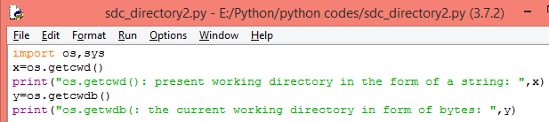
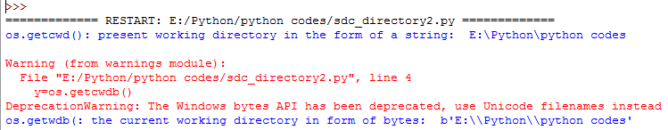
getcwd() and getcwdb()
Code
Output

Slide 49
mkdir()
Python method mkdir() create a directory named path with numeric mode mode.
Syntax: os.mkdir(path, mode = 0o777, *, dir_fd = None)
Parameter:
path: A path-like object representing a file system path.
mode (optional) : A Integer value representing mode of the directory to be created. The default mode is 0777 (octal).
dir_fd (optional) : A file descriptor referring to a directory. The default value of this parameter is None. If the specified path is absolute then dir_fd is ignored.

Slide 50
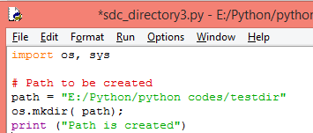
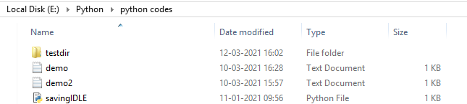
mkdir()
Code
Output
Directory Created

Slide 51

mkdir()
Code
Output
Directory Already Created, so error

Slide 52
rmdir()
Syntax: os.rmdir(path, *, dir_fd = None)
Parameter: path: A path-like object representing a file path. A path-like object is either a string or bytes object representing a path. dir_fd (optional) : A file descriptor referring to a directory. The default value of this parameter is None. If the specified path is absolute then dir_fd is ignored.

Slide 53
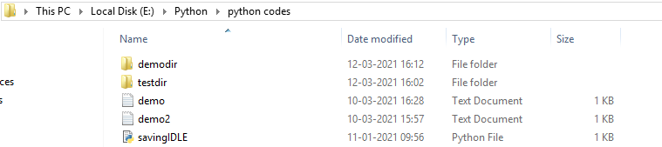
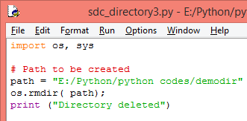
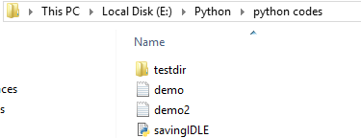
rmdir()
Before running the code
Code
Output- demodir not present in the path

Slide 54
Warning (from warnings module):
File "E:/Python/python codes/sdc_directory1.py", line 5
y=os.getcwdb()
DeprecationWarning: The Windows bytes API has been deprecated, use Unicode filenames instead
os.getcwdb() is supposed to get you the "bytes" version of the path, rather than a unicode path.
But on modern Windows system, the bytes version is UTF-16 encoded -- you really don't want that!

Slide 55
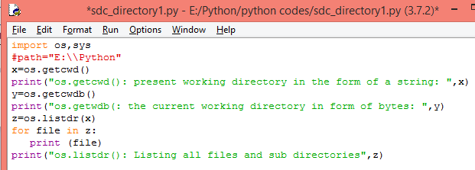
On using listdr
Traceback (most recent call last):
File "E:/Python/python codes/sdc_directory1.py", line 7, in <module>
z=os.listdr(x)
AttributeError: module 'os' has no attribute 'listdr'

